Slide 1

Star of Euphoria Gift Shop
Saiyra-Mary Jane Akbar

Slide 2
Gifts for the Soul

Slide 3

Press Release
Star of Euphoria celebrates Its Grand Opening with a Special Online Event. A New Venture Begins! Come Explore Your Spirits Euphoria with our enchanting gifts.
Metaphysical and Holistic Education | Syra-Marys Institute
Home | My Site 2
This grand opening event will feature 50% off on all items and a free gift, highlighting our commitment to provide unique items that inspire, motivate and nurture the spirit. It is our mission and desire to emanate love and light in our products that bring joy and well-being to our clients.

Slide 4

“I am excited to announce that Star of Euphoria products are designed to inspire your way to your inner light. Experience your Spirits’ Euphoria with our enchanting gifts. The Star of Euphoria Gift Shop aims to provide unique items that inspire, motivate and nurture the spirit. It is our mission and desire to emanate love and light in our products so that they can bring joy and peace to our clients. We have a variety of crystals, gemstones jewelry, oracle cards, meditation aids, dreamcatchers, angel figurines, colorful scented candles and gift baskets and much more to enchant you.” Saiyra-Mary Jane Akbar, Owner
Join us to celebrate a milestone in our journey and enjoy a day filled with surprises and delightful experiences. We look forward to welcoming you to Star of Euphoria Gift Shop and introducing you to our world of spiritual fulfillment, joy and well-being.

Slide 5

“If the dream is in your heart, then you’re meant to pursue it! I sincerely believe that we’re given certain desires on purpose, because those feelings will show us the path we’re supposed to walk.
If you’re at the beginning of your path here today, welcome aboard!” www.jennstevens.com/how-to-start-a-spiritual-business/

Slide 6


Target Markets
-Spiritual Seekers
-Yoga and Meditation Practitioners
-Energy and Holistic Wellness Seekers
-New Age Groups
-Gift Shoppers
-Wiccan Community

Slide 7
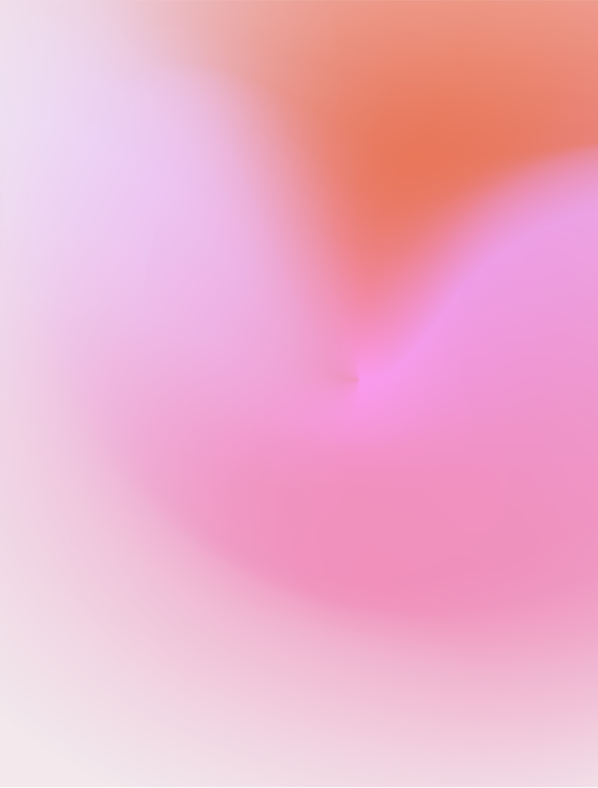
Euphoria
Definition from the Oxford Languages, www.languages.oup.com/google-dictionary-en/ describes Euphoria as “A feeling or state of intense excitement and happiness.”
Origin Greek, from Euphoros ‘borne well, health’
Ref. from En.wikipedia.org/wiki/Euphoria
“Euphoria (yoo-for-ee-a) is the experience (or affect) of pleasure or excitement and intense feelings of well-being and happiness. Certain and intense feelings of well-being and happiness. Certain natural rewards and social activities, such as aerobic exercise, laughter, listening to or making music and dancing, can induce a state of euphoria.”

Slide 8

Stars
Stars are heavenly bodies, planets, a luminous point in the sky-A light to guiding.

Slide 9
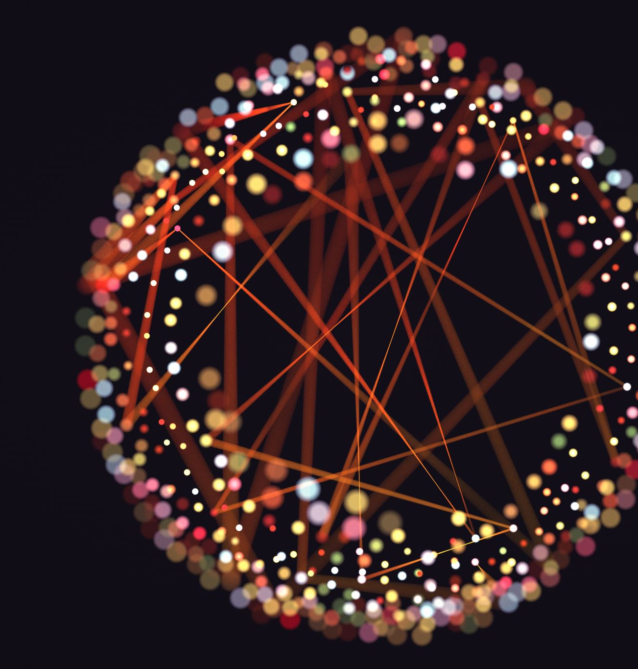
Star Symbolism from the same website.
“Something you may not have heard before is the belief that humans are actually made from stars. From a purely scientific viewpoint, humans are made up of all of the elements that were created by a star (or specifically, a supernova)
This is not just a belief hold by modern science either, Pythagoras is a well-known Greek philosopher from c. 500 B.C. who used the five-pointed star(pentagram) as a symbol which was later used to symbolize humankind. The five points represent earth, wind, fire, water, and spirit.”

Slide 10
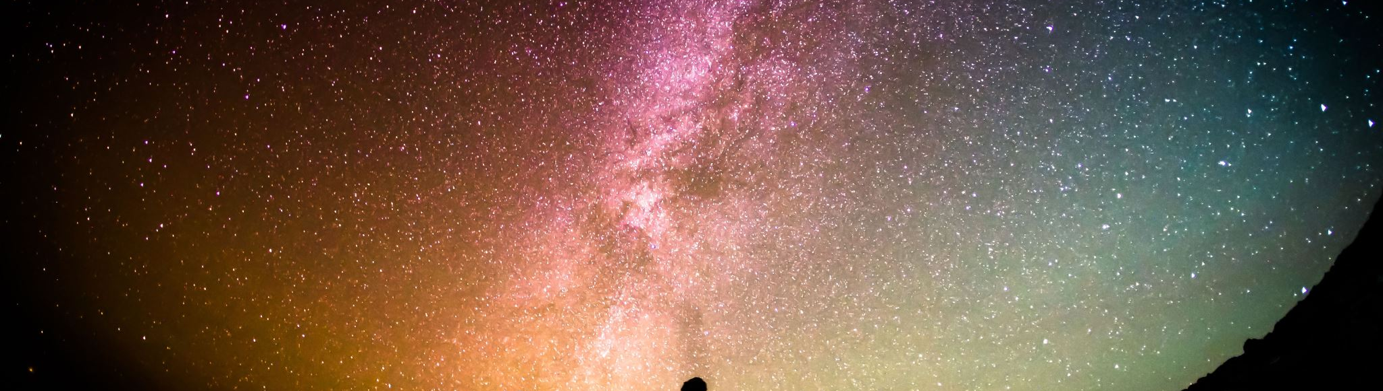
Stars are symbols of hope and guidance.
They are seen to give enlightenment and guidance to those that seek it. Many cultures around the world have initiations that require you to take meaning from the stars and use them as guidance on a spiritual journey.

Slide 11
We are made of Stars
https://symbolismandmetaphor.com/star-symbolism,
“Stars are seen as a symbol of hope and many different forms. The most notable of which is the good fortune you are said to receive when seeing a shooting star. This has led to the common act of making a wish upon a shooting star. People will wish upon a star to realize their deepest desires, wants, and needs and a star provides hope for many. Seeing a shooting star is also said to be of good luck and is another instance where wishes are made.”

Slide 12
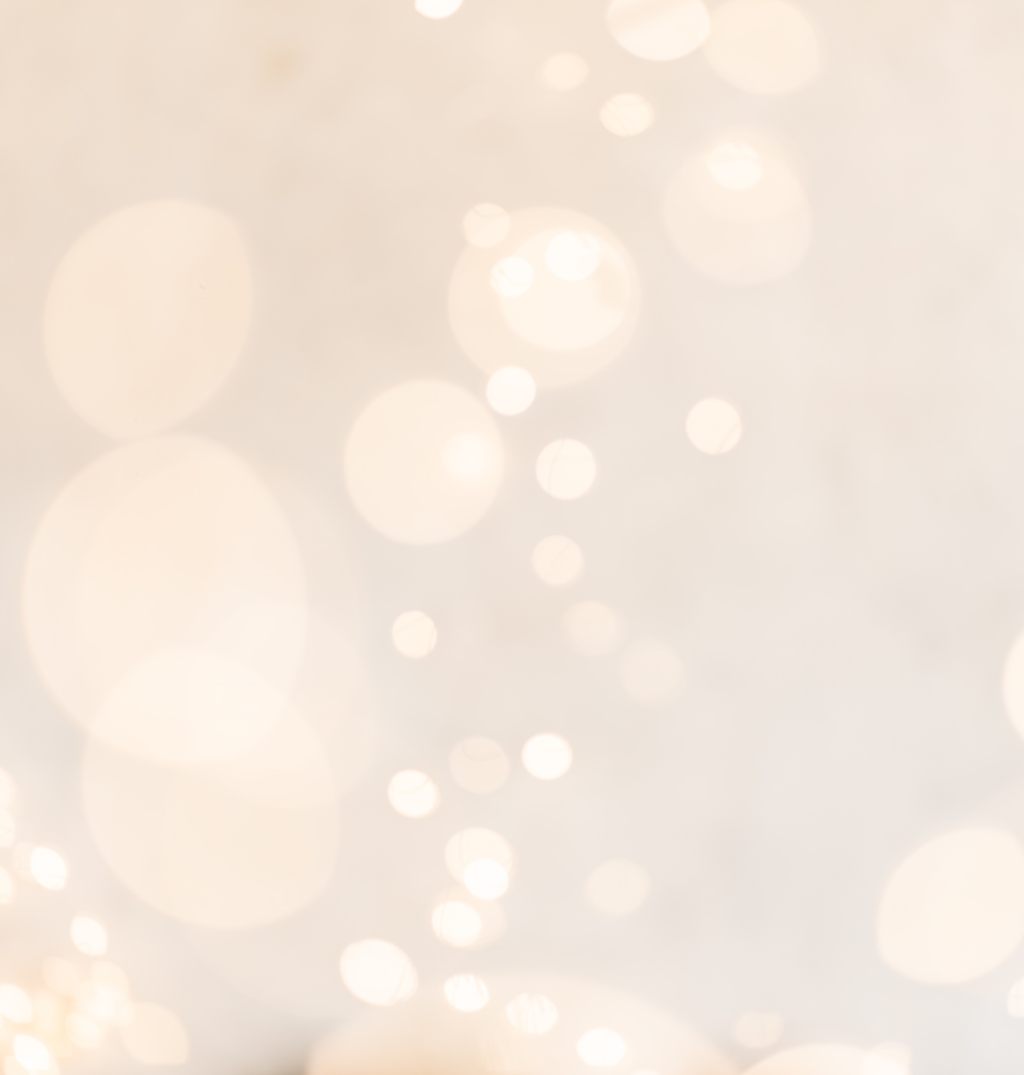
Stars are a guiding light and path for people.
“A four-pointed star is also synonymous with the cross in Christianity and is also used to represent the star of Bethlehem. Again, this is a sign of divine powers and is used to symbolize guidance for those that choose to follow it.”
“… long before we had access to a GPS, maps, or a compass, often referred to as a guiding light, a fixed star was something to guide travelers to their destination. Merchants that would cross deserts to trade in foreign lands would use a star to guide them and this skill led to merchants being seen in high regard as they could navigate the desert despite being surrounded by vast areas of nothing.”
https://symbolismandmetaphor.com/star-symbolism,

Slide 13

Business Goals
Mission Statement: To Provide unique Items that inspire, motivate, and nurture the spirit. It is our mission and desire to emanate love and light in our products that bring joy and peace to our clients.

Slide 14
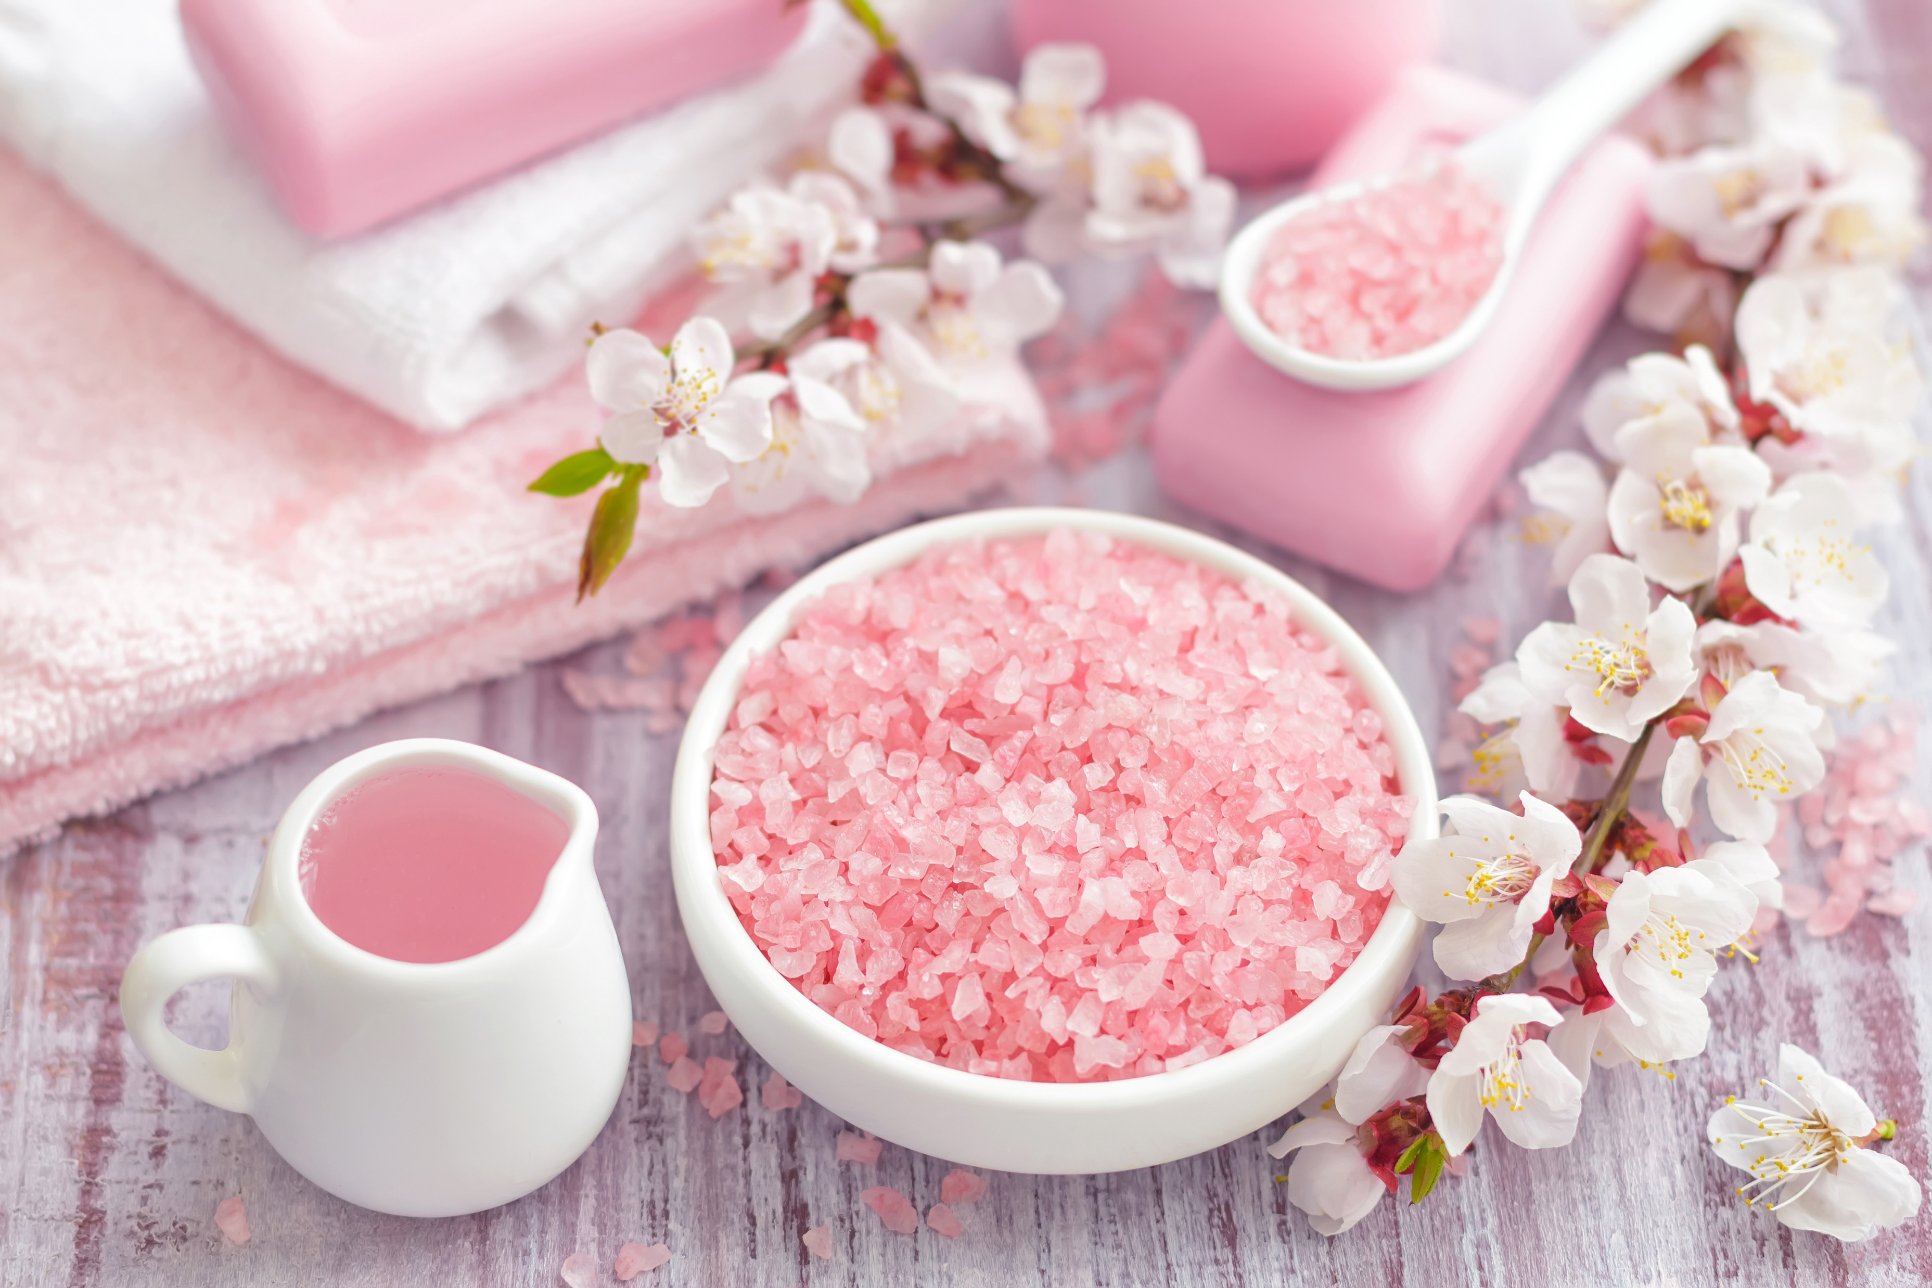
Vision
The Inner Journey
Spiritual Awakening
The Star of Euphoria displays a wide range of unique products of the highest quality. We offer crystals, gemstones and gemstone jewelry, oracle cards, scented candles, incense, meditation aids, dreamcatchers, windchimes, and some metaphysical technologies. Along with that I will offer specialty gift-baskets for special occasions.

Slide 15
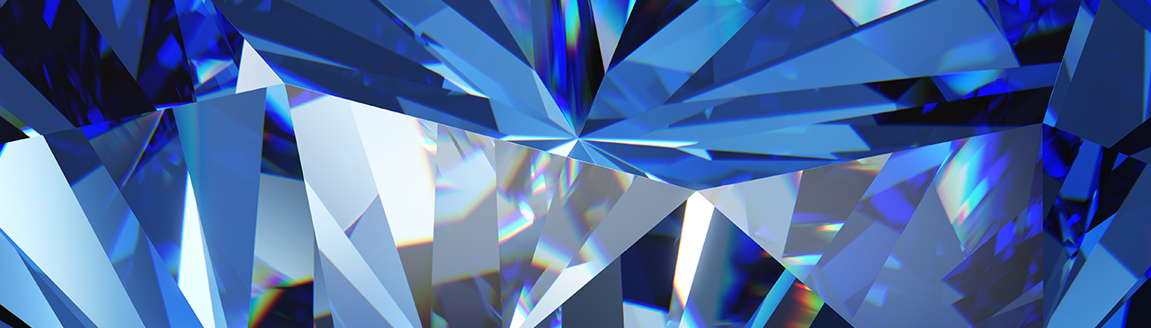
Self-Healing
Our online gift shop provides a unique experience to customers of all ages, who seek to pursue self-healing, self-development, spiritual growth or just seeking plain fun.

Slide 16
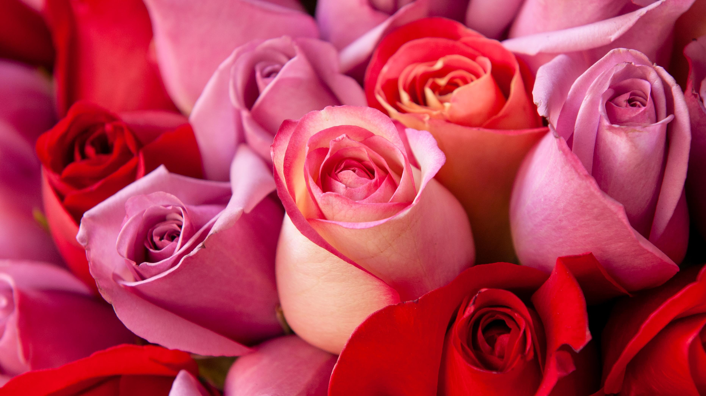
By nourishing our inner spiritual self, we can create a more fulfilled and complete expression of ourselves.

Slide 17
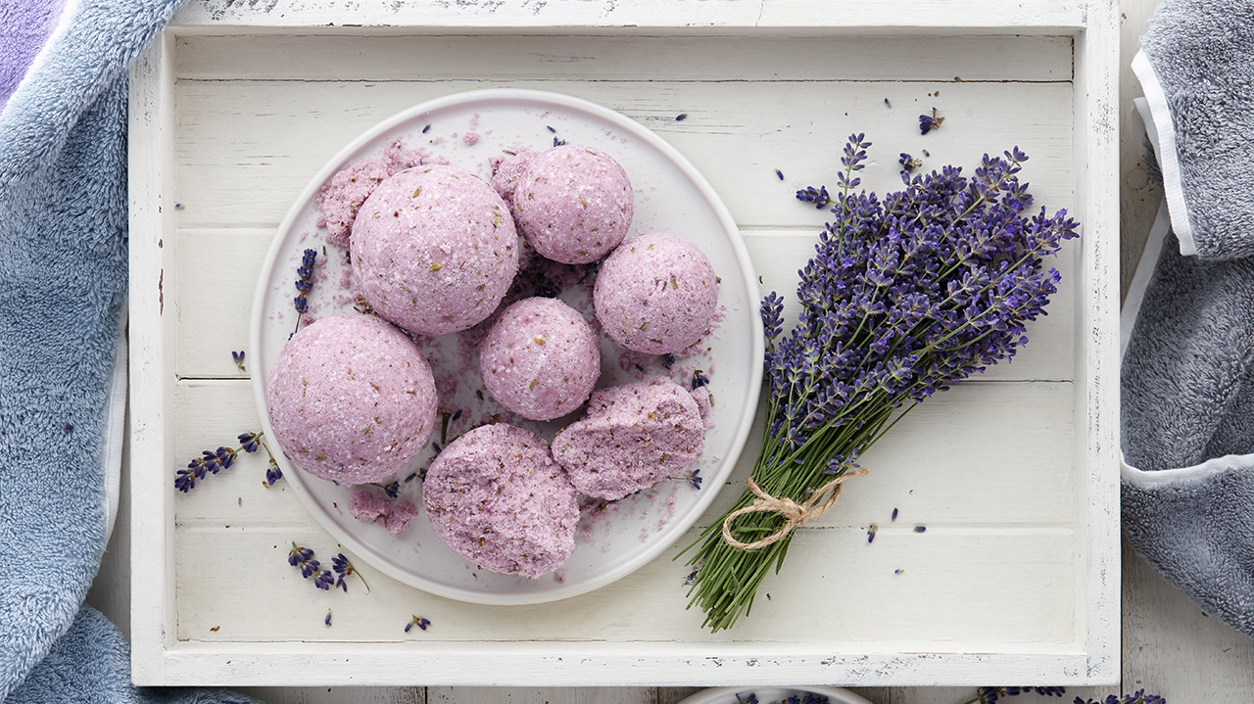
The Star of Euphoria is a warm and peaceful space aimed to bring a loving environment, for all individuals. To be the guiding light to one’s own spiritual exploration.

Slide 18
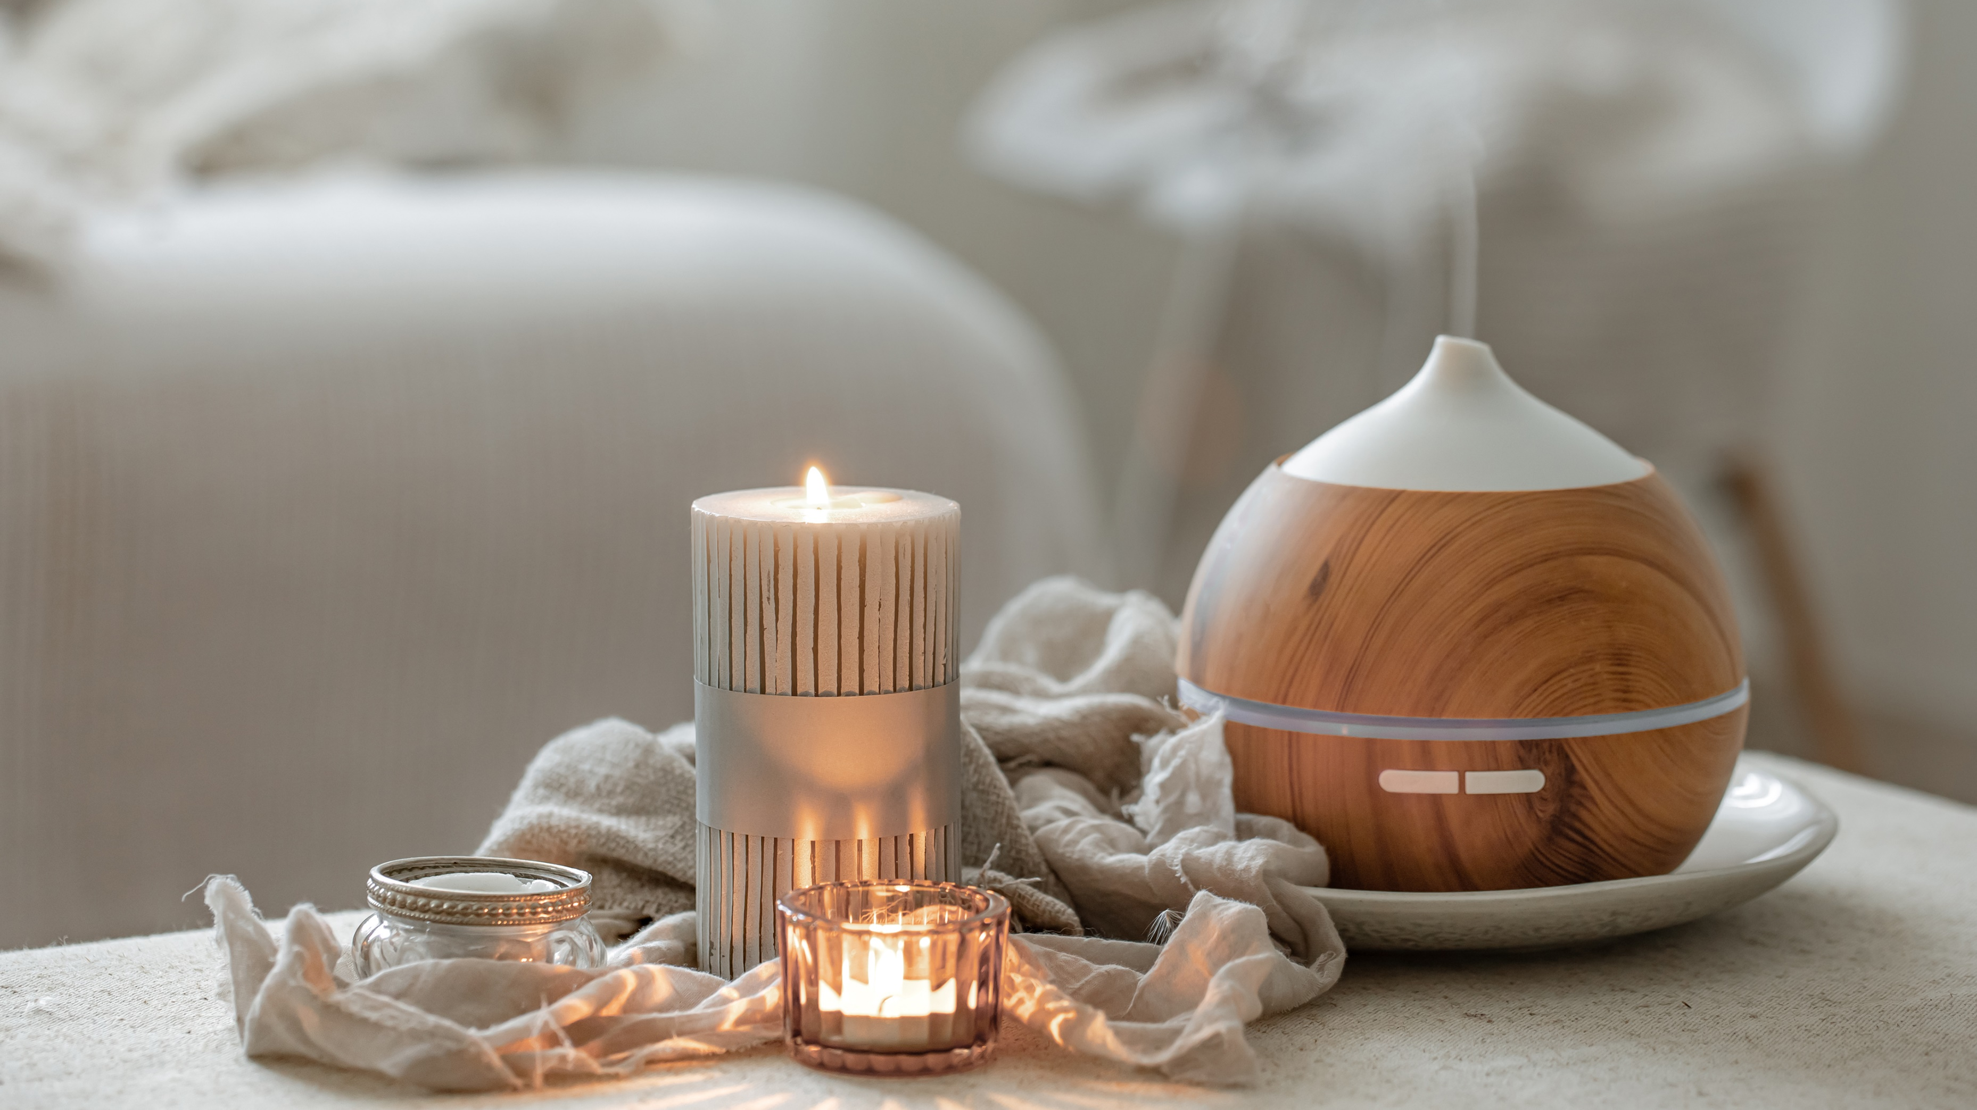
To offer wellness and crystal subscription boxes, which is the option to deliver a specific set of metaphysical items to clients on a monthly, or on a recurring basis. We can also tailor the subscription boxes to the customer’s needs and desires.

Slide 19
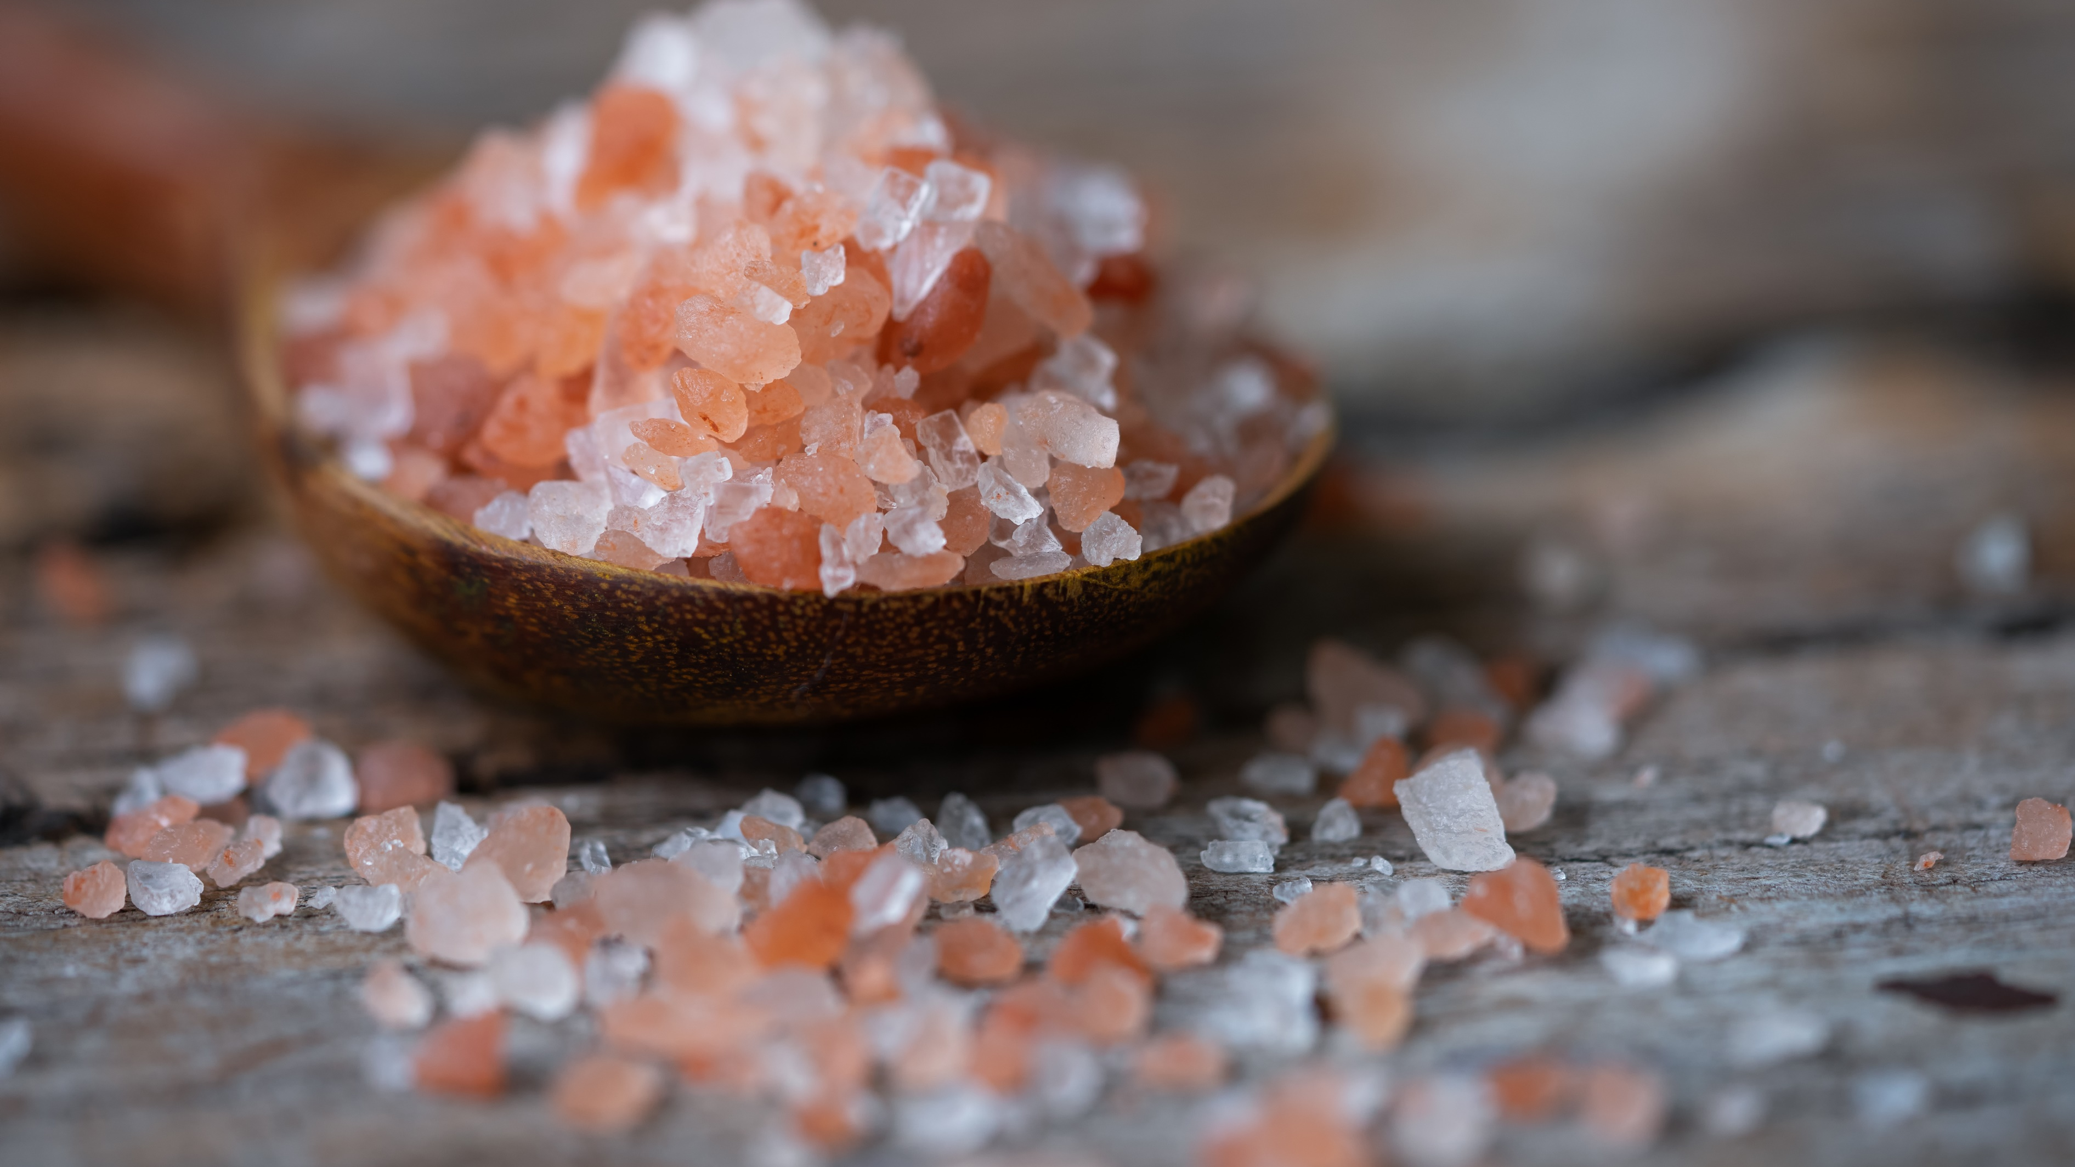
Experience your spirit’s euphoria.

Slide 20
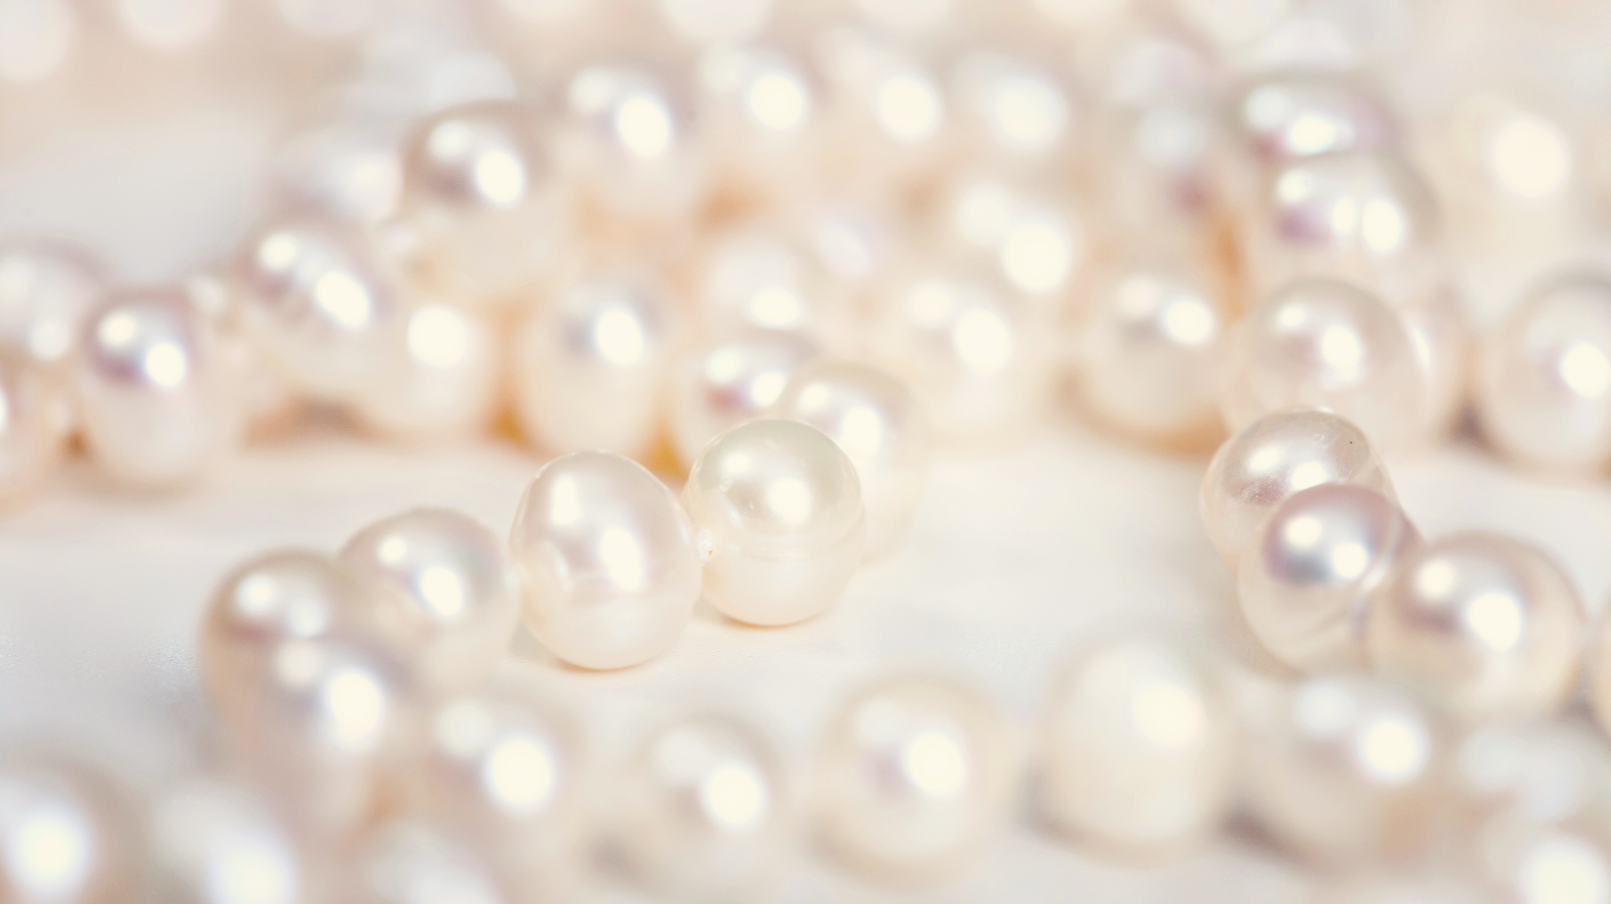
All ancient teachings have evolved to a new level – a spiritual level of peaceful coexistence with all human cultures and religions, and ways of being. If we follow the path, it can lead us to a golden age.

Slide 21
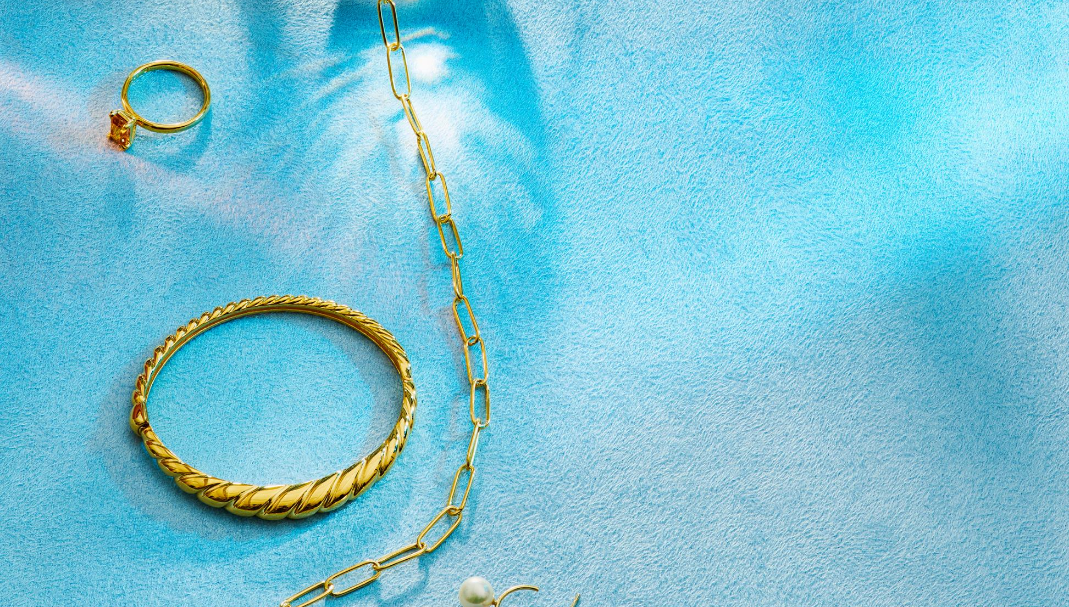
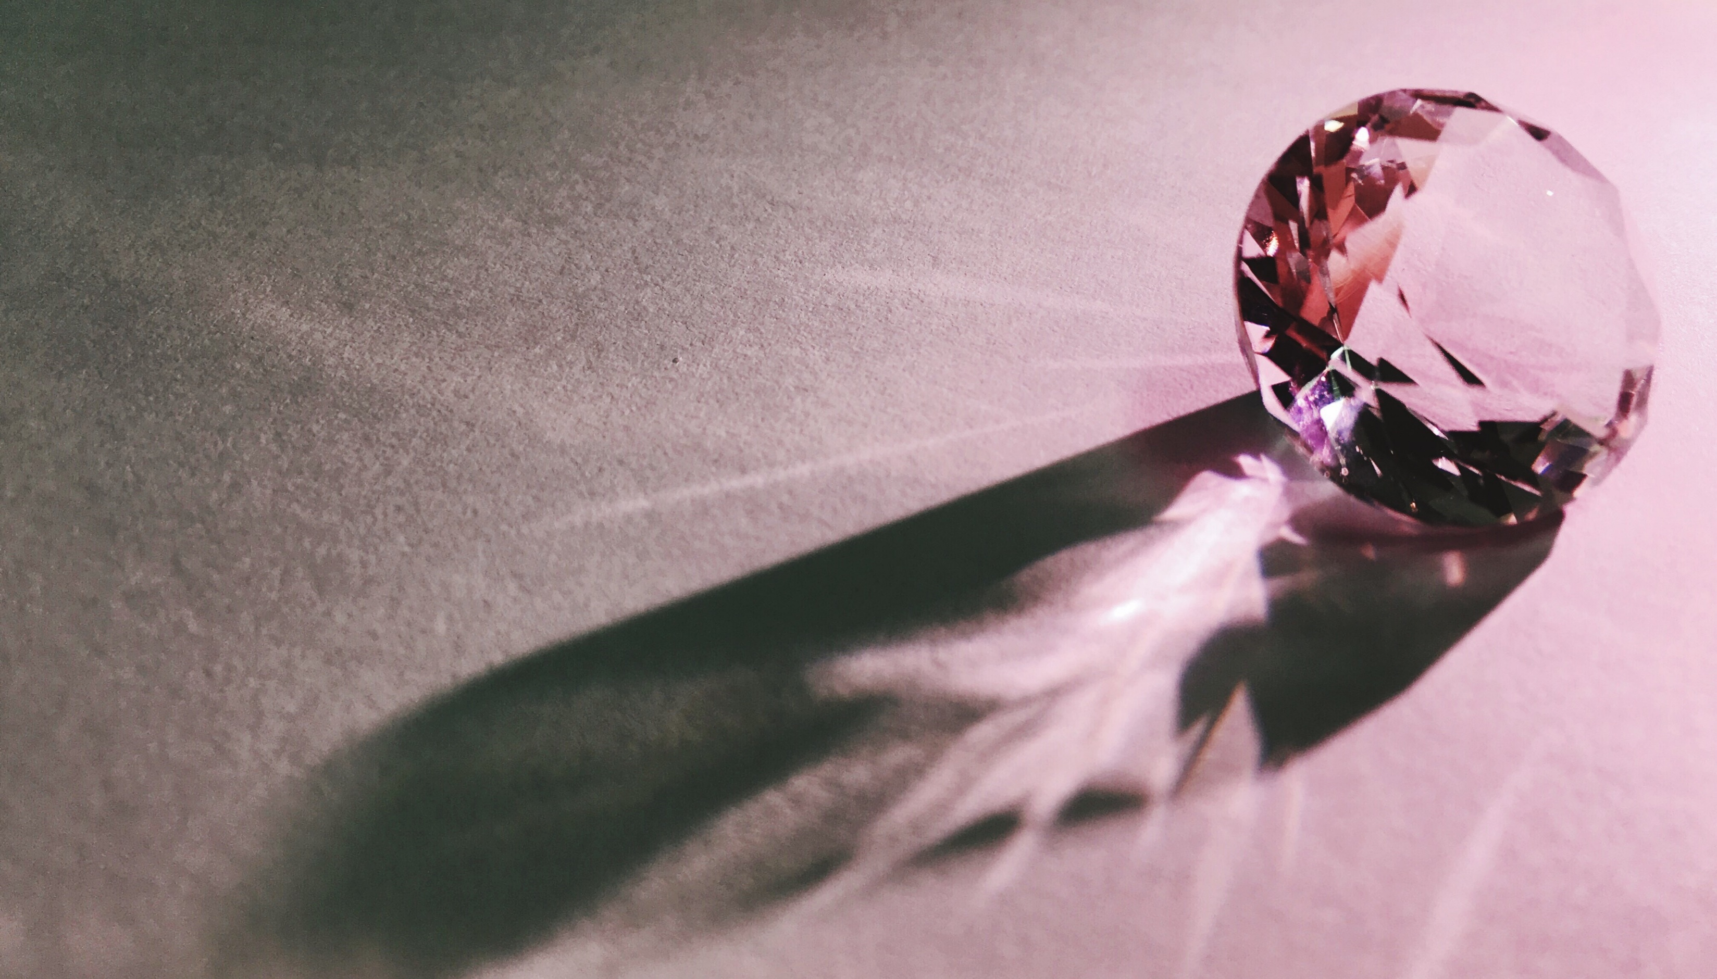
Our Philosophy
To be the best that you can be, so you can live a life filled with health, wellness and beauty. A life that truly fulfills one’s inner yearnings.

Slide 22


Our Belief
Star of Euphoria believes that in our offering our customers high-quality items at reasonable prices, along with a great customer experience we can create a long-lasting relationship

Slide 23

We look forward to welcoming you to The Star of Euphoria Gift Shop and introducing you to our world of spiritual fulfillment, joy and well-being.

Slide 24


Conclusion
Dare to Enter and Experience your Spirits’ Euphoria. The Star of Euphoria Gift Shop aims to provide unique items that inspire, motivate and nurture the spirit.

Slide 25

The Beginning…

